Slide 1
Simulation of water and sand with Material Point Method (MPM)
Zhuo Liu
12/9/2021
Notes:
Hello everybody, my project is about physics based simulation with material point method.

Slide 2
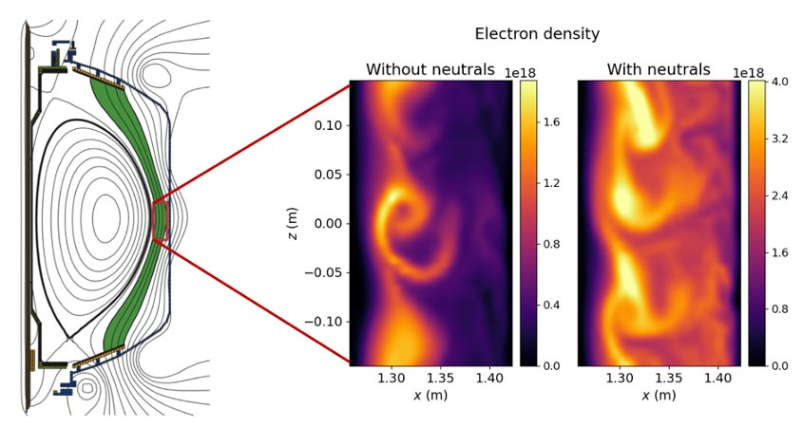
Motivations
Simulating natural phenomena for virtual worlds is challenging.
The Particle-In-Cell (PIC) (dates back to 1963) method is a central tool for simulation over a wide range of physics studies.
https://taichi.graphics/
Notes:
In computer graphics applications such as videos games and movies, we often encounter the problem of simulating natural phenomena, like water snow, sand… And this is actually a task that remains challenging in today’s world.
In physics research, Particle-in-Cell (PIC) simulation is widely used to study plasma for more than 50 years. This is a snapshot the cross section of a fusion machine by the modern PIC code, and you can see the plasma turbulence is captured. Therefore, it is quite naturally to do physics based animation with similar technique. MPM has been shown to be a very effective method for simulating various materials. This cartoon is created using cutting-edge Material point method software.

Slide 3
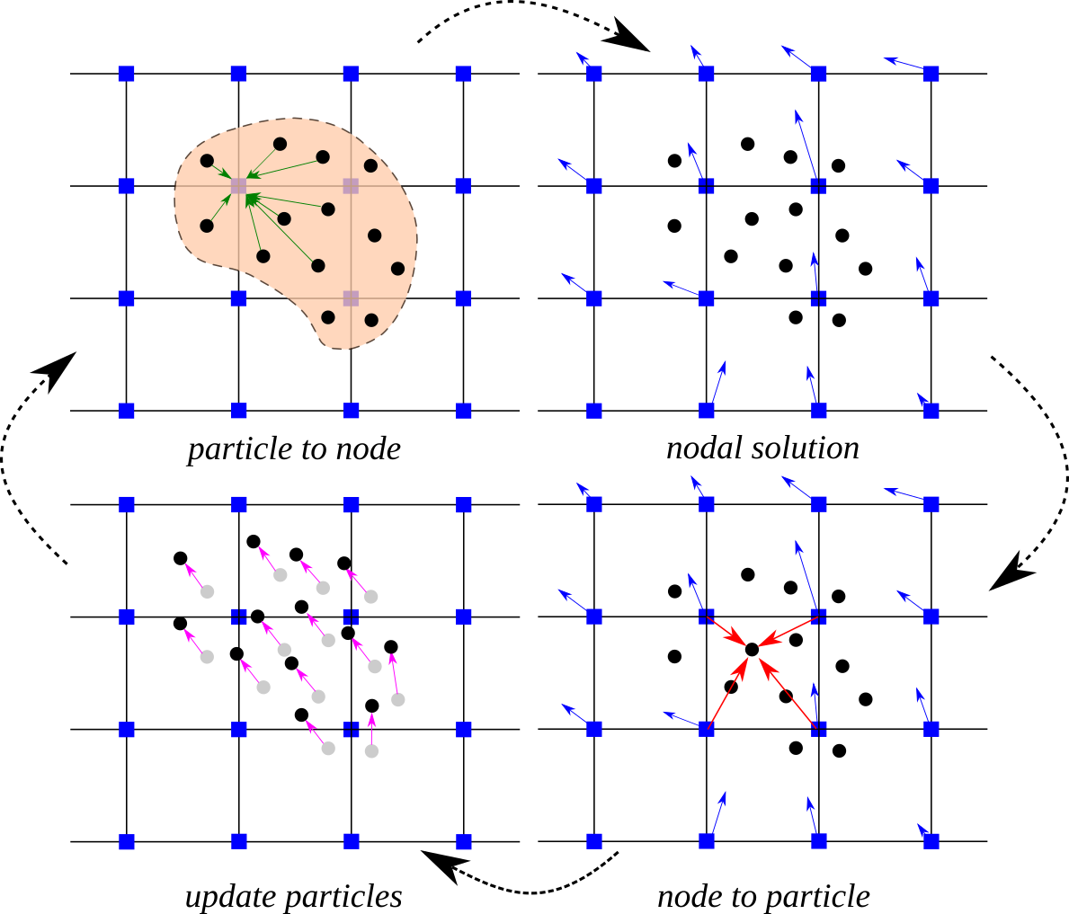
Material Point Method
Material points (Lagrangian) + fixed uniform grids (Eulerian)
Track variables such as position, velocity of material points
Solve governing equations on grids
Advantages
No mesh distortion, universal for large deformation problems
Track of material points, history dependent variables can be easily accommodated
https://www.cb-geo.com/research/mpm/
Notes:
So, Material Point Method (MPM) mainly rises as the generalization of Particle-in-Cell (PIC) method.
So here is an illustration of the algorithm. The plot on the upper right is the representation of material points overlaid on computational grids. These arrows represent material point state vectors (suchas mass, velocity, etc.) being projected to the nodes of the computational grid. And then the equations of motion are solved onto the nodes. After that, the updated grid kinematics are interpolated back to the material points. Finally, The state of the material points is updated, and the computational grid is reset
There are several advantages for MPM. The biggest one is the internal force is self-consistently computed on the uniform grids and it’s easy to simulate several different materials simultaneously.

Slide 4
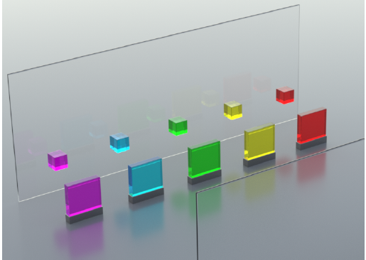
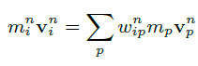
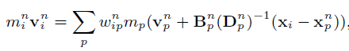
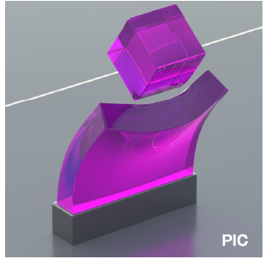
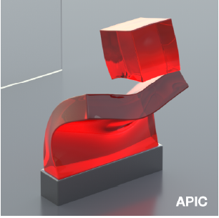
Affine Particle-in-Cell
When transfer velocities from particles to grids…
PIC
APIC
APIC: Augment each particle with a locally affine, rather than locally constant, description of the velocity.
Advantages
Conserves angular momentum
Captures non-rigid motion such as shearing
[Chenfanfu Jiang 2015]
Notes:
One relatively new technique I am implementing in this project is affine particle-in-cell proposed by Jiang in 2015. When transfering physical variables between particles and grids, the traditional PIC method just use a locally constant description of the velocity and there is information loss. APIC prevents this loss of information by augmenting each particle with a locally affine, description of the velocity. This not only allows for exact conservation of angular momentum across the transfers between particles and grid but also allow it to capture non-rigid motion such as shearing .
The figure shows the collision of jelly cubes. APIC on the right hand side shows better angular momentum conservation than PIC.

Slide 5
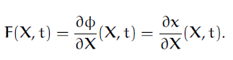
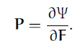
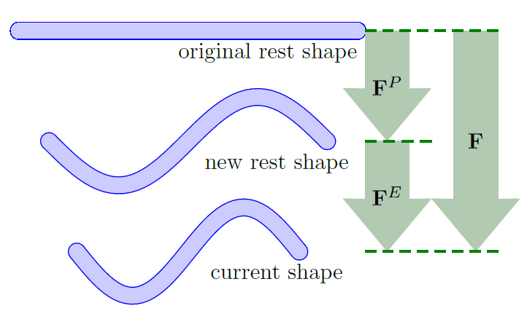
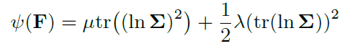
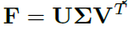
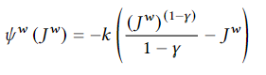
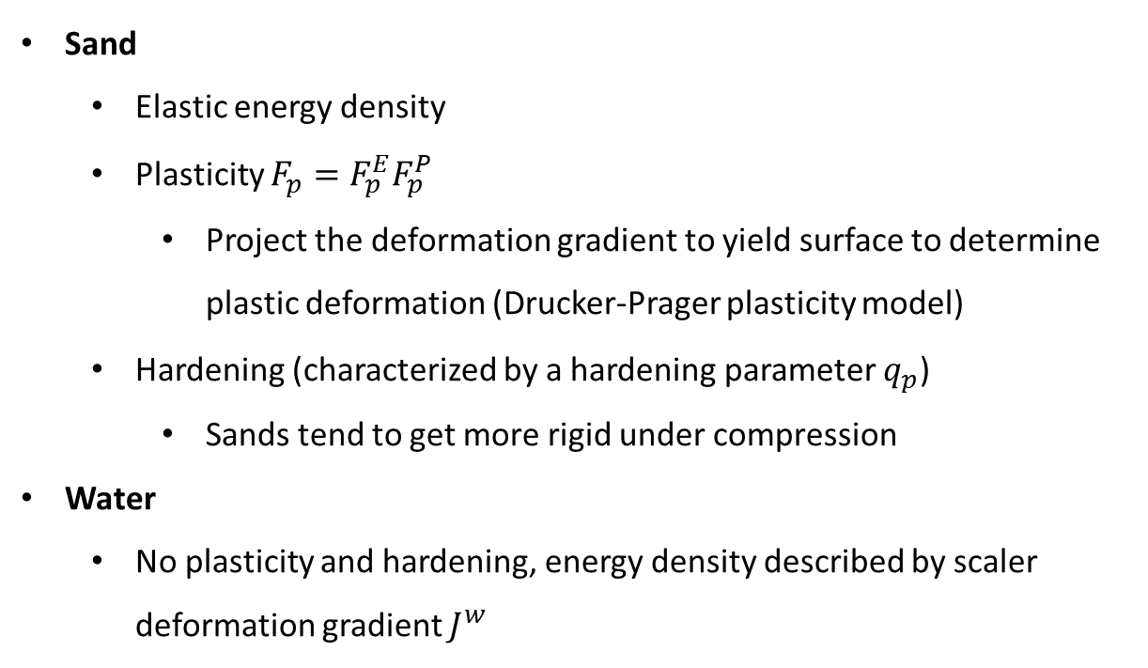
Constitutive model
Internal stress is evaluated by deformations
Sand
Elastic energy density
Plasticity $F_{p}=F_{p}^{E}F_{p}^{P}$
Project the deformation gradient to yield surface to determine plastic deformation (Drucker-Prager plasticity model)
Hardening (characterized by a hardening parameter $q_{p}$)
Sands tend to get more rigid under compression
Water
No plasticity and hardening, energy density described by scaler deformation gradient $J^{w}$
[Gergely Klar 2016]
[Andre Pradhana Tampubolon 2017]
Notes:
To describe different material properties, we need a model for calculating the internal force. A constitutive model is relating the internal stress with deformation gradient, denoted F. For elastic materials, stress P can be derived from an strain energy density function. For water the energy density function is like this.
Sand is more complicated because the deformation is factored into elastic and plastic parts. I am using a recent model proposed in 2016. While the internal stress is only related to the elastic deformation, the plastic part representing the portion of the material history that has been forgotten is also changing every step. Another thing to handle is hardening effect because sand will tend to get more rigid under compression. I have covered the exact model in my final write up, and I will not go into the details here for the time reason

Slide 6
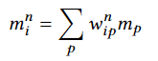
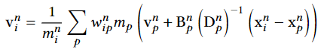
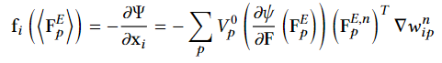
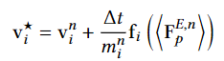
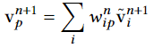
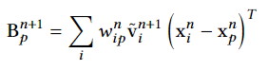
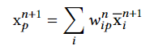
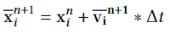
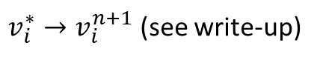
Algorithm overview
P2G
Transfer mass
Transfer velocity
Compute force
Update Grid
Update grid velocity
Apply collision and friction with borders
$v_{i}^{∗}→v_{i}^{n+1}$ (see write-up)
G2P
Transfer velocity
Transfer affine momentum
Update Particle
Update particle position
Update particle deformation (plasticity, hardening)
(see write-up)
Notes:
Here is an overview of the algorithm and related equations. Note that there are some other details I have not talked about such as collision and friction with the borders. I’ve covered all these in my write-up. I will skip this for now.

Slide 7

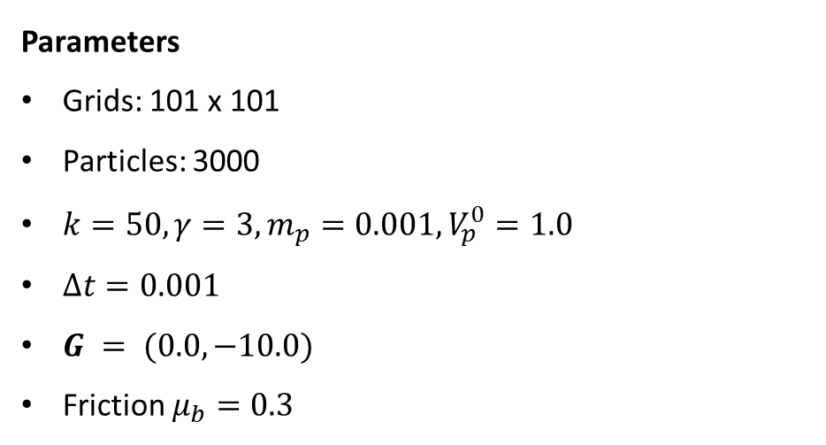
Results: Water
Rendering
With OpenGL 3.3
Instancing: create one blue sphere mesh and reuse it 3000 times with a instance matrix in the shader.
Parameters
Grids: 101 x 101
Particles: 3000
$k=50, γ=3, m_{p}=0.001, V_{p}^{0}=1.0$
$Δt=0.001$
$G = (0.0, −10.0)$
Friction $μ_{b}=0.3$
Notes:
I I am using instancing method for rendering, that is, creating one blue sphere mesh and reuse it thousand times with a instance matrix in the shader.
The water is falling from the top with some initial speed and then hits on the ground under the influence of gravity and collides with the boundaries. Some turbulence features are also captured by the model. Note that there are only 3000 particles in the system so the simulation doesn’t look that ogdd. However, this 10 seconds video took me an hour to render on my laptop.

Slide 8
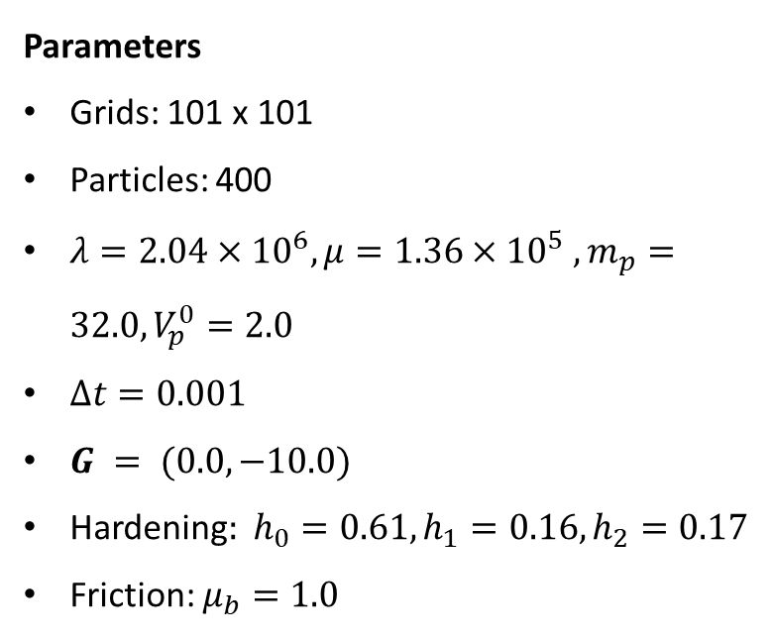
Results: Sand
Parameters
Grids: 101 x 101
Particles: 400
$λ=2.04×{10}^{6}, μ=1.36×{10}^{5} ,m_{p}=32.0, V_{p}^{0}=2.0$
$Δt=0.001$
$G = (0.0, −10.0)$
Hardening$: h_{0}=0.61, h_{1}=0.16, h_{2}=0.17$
Friction: $μ_{b}=1.0$
Notes:
Here is a block of sand falls down under the influence of gravity. With the plasticity and hardening model, the sand forms a smooth granular flow and piles up at the bottom. Updating the sand involves more matrix algebra so it is even slower. So I only use 400 particles here.

Slide 9
Future work
Implement it on GPU and parallelize the code
Water and sand coupling
Moving-least square MPM
…
Notes:
There are some potential work that I don’t have to do them now. The most important improvement should be implementing the code on GPU and parallelize the code because the it is super slow now.
So this is all I would like to present for the project and thank you for your attention.

Slide 10


Slide 11


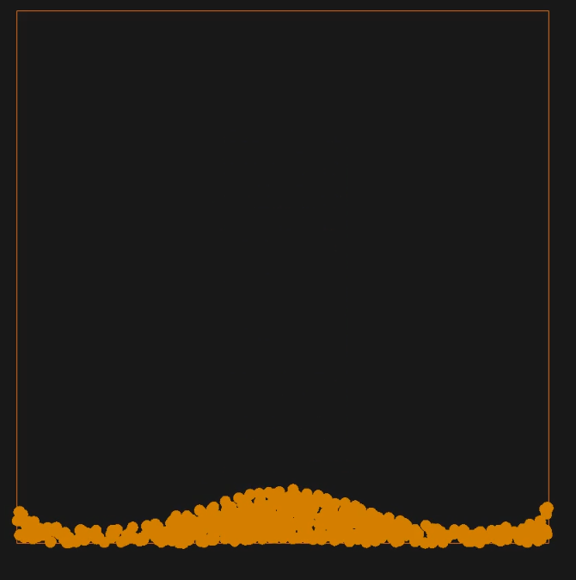
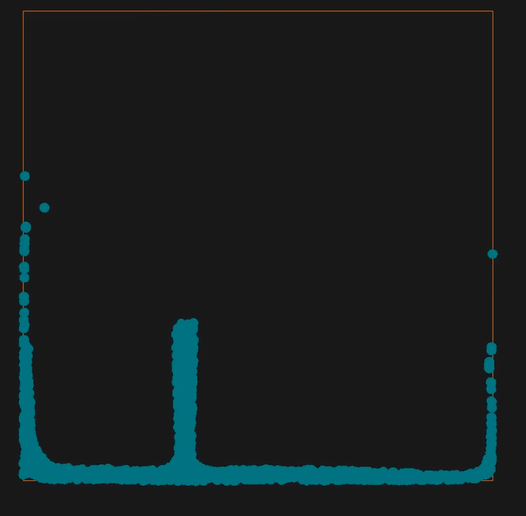


Slide 12
